Slide 1
Building an MCP Server with STDIO Transport MCP Server Workshop

Slide 2
What we'll build:
MCP Server with STDIO transport
Business Central API integration
Claude Desktop integration
Tools, Prompts & Resources
Duration:
20-30 minutes hands-on
Repository: github.com/javiarmesto/Workshop-MCP-Server-Directions-lab

Slide 3
Workshop Structure & Objectives
Learning Outcomes
Understand MCP architecture
(Tools, Prompts, Resources)
Configure STDIO transport for Claude Desktop
Create Business Central API integrations
Build custom MCP tools with copy-paste examples

Slide 4
Workshop Structure & Objectives
9-Step Workshop Flow
Steps 1-4: Environment Setup
Python 3.12+ virtual environment
Install dependencies (mcp, httpx, msal)
Validate setup with validate_workshop.py
Steps 5-7: MCP Server Configuration
Configure Claude Desktop (claude_desktop_config.json)
Test connection with Claude
Verify tools are available
Step 8: Connection Validation
Test MCP tools in Claude
Verify prompts and resources
Step 9: Hands-On Exercises ⭐
Part A: Test existing tools (get_customers, get_currency_exchange_rates)
Part B: Implement new tools (get_sales_orders, get_payment_terms)

Slide 5
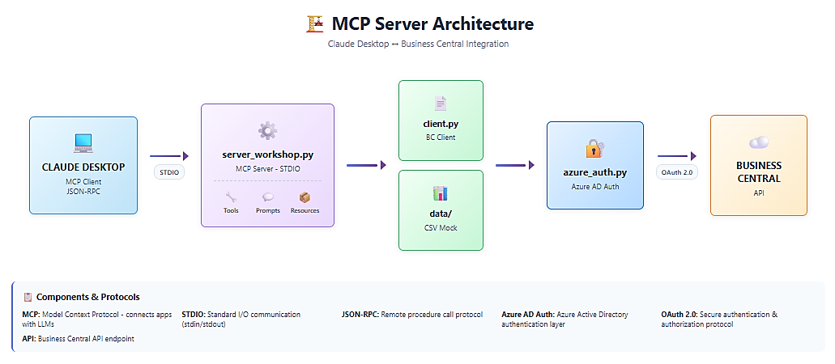
MCP Architecture Overview
System Architecture

Slide 6
MCP Architecture Overview
System Architecture
Key Components
STDIO Transport: Direct process communication (no ports/networking)
Tools: Functions Claude can call (get_customers, get_items, etc.)
Prompts: Pre-configured templates (customer_analysis, vendor_analysis)
Resources: CSV/JSON data files exposed to Claude
Target: Business Central API integration (OAuth 2.0 + Standard API v2.0)
Fallback: Mock mode available if BC access unavailable (not recommended)

Slide 7
Configuration & Setup
1. Download ZIP and extract
Go to: github.com/javiarmesto/Workshop-MCP-Server-Directions-Lab
Click "Code" → "Download ZIP" → Extract
cd Workshop-MCP-Server-Directions-Lab-main
2. Create virtual environment
python -m venv workshop-env
.\workshop-env\Scripts\activate # Windows
source workshop-env/bin/activate # macOS/Linux
3. Install dependencies
pip install -r requirements.txt
4. Validate setup
python validate_workshop.py
Quick Setup Commands

Slide 8
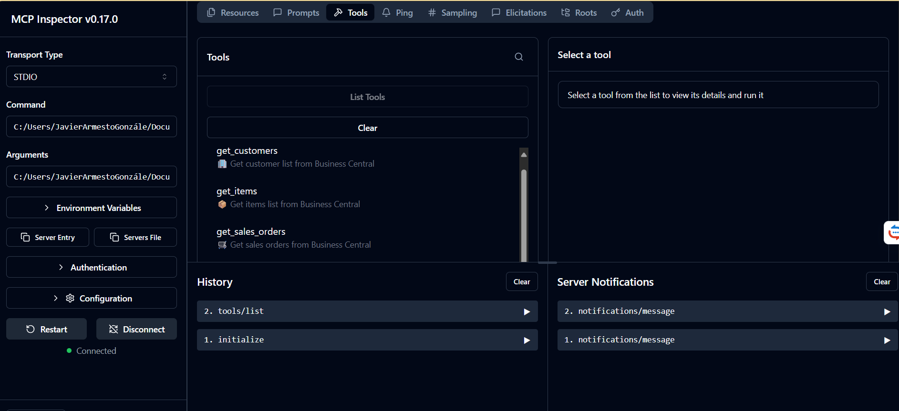
TEST MCP SERVER
USE MCP INSPECTOR
RUN on terminal: npx @modelcontextprotocol/inspector

Slide 9
TEST MCP SERVER
USE MCP INSPECTOR
"COMMAND": "C:/Users/YOUR_USERNAME/Documents/AL/Workshop-MCP-Server-Directions-Lab/workshop-env/Scripts/python.exe",
"ARGUMENTS": ["C:/Users/YOUR_USERNAME/Documents/AL/Workshop-MCP-Server-Directions-Lab/server_workshop.py"]

Slide 10
Hands-On Exercises
Exercise 1: Test get_customers + customer_analysis
"Show me the list of customers"
"Give me a customer analysis using the prompt"
Step 9
Part A: Testing Existing Tools (10 min)
Exercise 2: Test get_currency_exchange_rates
"Show me currency exchange rates"
"Get exchange rates for USD"

Slide 11
Hands-On Exercises
Exercise 3: Implement get_sales_orders
Add get_employees() method in src/client.py
Register tool in server_workshop.py (list_tools)
Implement handler in server_workshop.py (call_tool)
Test: "Show me sales orders"
Exercise 4: Implement get_payment_terms
Add get_projects() method in src/client.py
Register tool in server_workshop.py (list_tools)
Implement handler in server_workshop.py (call_tool)
Test: "Show me payment terms"
Step 9
Part B: Implementing New Tools (15 min)

Slide 12
Resources
Workshop Materials:
WORKSHOP_GUIDE_EN.md - Complete step-by-step guide
Validate_workshop.py - Setup validation script
Vata/ - Mock CSV files for testing
Repository: github.com/javiarmesto/Workshop-MCP-Server-Directions-labs
MCP Protocol:
Spec: spec.modelcontextprotocol.io
Docs: modelcontextprotocol.io
Python SDK: pip install mcp
Business Central:
BC API Reference
Azure AD Auth
Documentation & Materials

Slide 13
Next Steps
Now that you understand the pattern, you can add more tools using other standard Business Central APIs:
salesInvoices - Sales invoices
purchaseOrders - Purchase orders
purchaseInvoices - Purchase invoices
vendors - Vendor list (similar to customers)
dimensions - Dimension values
shipmentMethods - Shipping methods
Pattern to follow:
Create mock CSV data
Add async method in client.py
Register tool in server_workshop.py (definition + handler)
Test in Claude Desktop

